Slide 1
World Happiness
Presented By: Michael Anaga
Created on: 6/7/2023

Slide 2
Table of Contents
World Happiness
Purpose Statement
Tell your story with Data
Conclusion
Appendix

Slide 3
What are we talking about?
Notes:
Transition Slide

Slide 4
Objective
Identify if there are geographic, demographic, and/or economic factors that contribute to a happier life.

Slide 5
Present Data
Notes:
Transition Slide

Slide 6
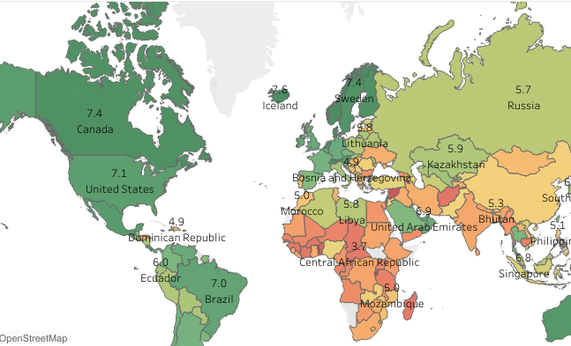
Geographic
Notes:
We analyzed the data set, consisting of data collected from residents of European countries between 2015 and 2019. The data contained demographic and economic data for individuals within each country, including population, Gross Domestic Product (GDP), and the happiness score per person.

Slide 7

Geographic
Happiness Score
Notes:
We began by creating a heat map of the happiness score for each country with the average of 5 years. Where the number within each country represents the overall score and the colors represent how high or how low the score is on a scale. So, the darker green the country is, the higher the numeric happiness score for that country. The deeper red that the country is, the lower the happiness score and overall numeric value.

Slide 8
Geographic
Happiness Score
Happiness levels vary widely by country.
Notes:
However, as high and low scores are spread sporadically throughout the map, there is little correlation that we find between geographical location and
happiness. Finally, we concluded that the geographical location alone was not a strong indicator of happiness.

Slide 9
Geographic
Happiness Score
Happiness levels vary widely by country.
Little correlation that we find between geographical location and happiness
Notes:
However, as high and low scores are spread sporadically throughout the map, there is little correlation that we find between geographical location and
happiness. Finally, we concluded that the geographical location alone was not a strong indicator of happiness.

Slide 10
Geographic
Happiness Score
Happiness levels vary widely by country.
Little correlation that we find between geographical location and happiness
Geographical location alone was not a strong indicator of happiness.
Notes:
However, as high and low scores are spread sporadically throughout the map, there is little correlation that we find between geographical location and
happiness. Finally, we concluded that the geographical location alone was not a strong indicator of happiness.

Slide 11
Happier countries:
Correlated demographics and economics?
Notes:
Our next step was to identify the demographic and economic differences between the higher and lower countries to isolate the correlated features between them.

Slide 12
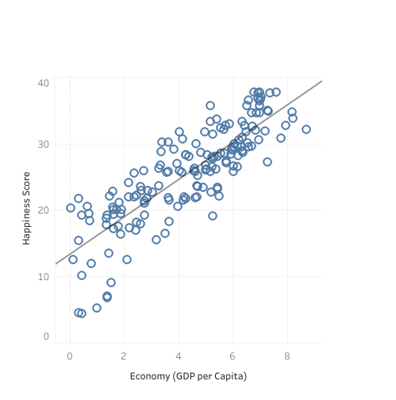
Wealth

Slide 13
Notes:
We created a scatterplot in which we plotted countries based on their happiness score and the population to see if there was a correlation between the two.

Slide 14

Happier
Notes:
The higher up something is on the scatterplot, the happier the country is.

Slide 15

Happier
Wealthier
Notes:
The further to the right that the country is plotted, the wealthier the country.

Slide 16
Testing for Linear Correlation
Happier
Wealthier
Notes:
And the line that goes between the two is testing for correlation (if they are related to one another).

Slide 17
Wealth
Positive correlation between Happiness and Gross Domestic Product (GDP)
Notes:
We found a positive correlation between happiness and wealth overall of the country. Now, we found this because the correlation coefficient between
the two different factors being happiness and wealth was 0.70

Slide 18
Wealth
0.70
Positive correlation between Happiness and Gross Domestic Product (GDP)
Notes:
A correlation coefficient is a measure of strength and direction of the linear relationship between two variables. In other words, the closer to one that the number is, the more positively correlated they are. Meaning, when one of the variables goes up, so does the other one.

Slide 19
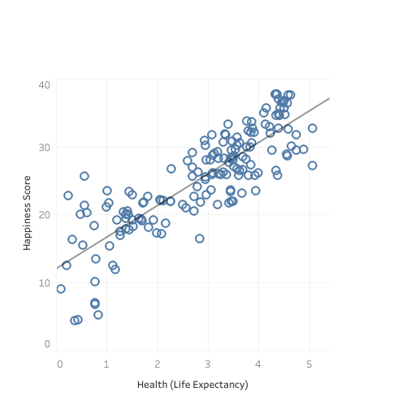
Health
0.71
Stronger correlation between Happiness and Health (Life Expectancy)
Notes:
We then analyzed how the happiness of the country relates to the overall health of the country. Because if we know if health is related to happiness and we know that wealth is related to happiness, then we can infer additional information through that. So, we found that there is a stronger correlation between with a 0.71 correlation coefficient.

Slide 20
Health
0.71
Stronger correlation between Happiness and Health (Life Expectancy)
Are happy people healthy, or are healthy people happy?
Notes:
We did find that there is a positive correlation between happiness and health, but the question remains, are happy people healthy or are healthy people happy?

Slide 21
Health
0.71
Stronger correlation between Happiness and Health (Life Expectancy)
Are happy people healthy, or are healthy people happy?
What contributes to a longer life expectancy?
Notes:
And finally, what contributes to a longer life expectancy? If we know that longer life expectancy is related to happiness, what is it that helps create longer life expectancy within a country?

Slide 22
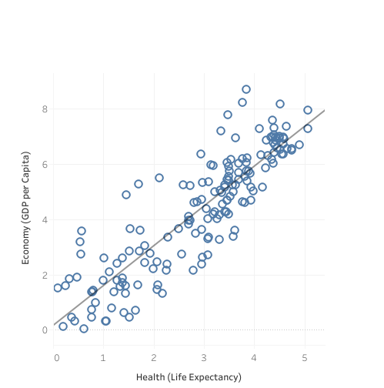
Wealth Vs Health
0.77
Even stronger correlation between Gross Domestic Product (GDP) and Health (Life Expectancy)
Notes:
Next we found an even stronger correlation between GDP and health.

Slide 23
Wealth Vs Health
0.77
Even stronger correlation between Gross Domestic Product (GDP) and Health (Life Expectancy)
Wealthy and healthy countries have higher average happiness levels
Notes:
We found that richer countries have a higher average happiness level.

Slide 24
Conclusion

Slide 25
Conclusions
1
Wealthier countries and economic growth tend to contribute to higher average happiness levels.

Slide 26
Conclusions
1
2
Wealthier countries and economic growth tend to contribute to higher average happiness levels.
Healthier countries often have happier populations, and this correlation is often linked to their level of wealth.

Slide 27
Conclusions
1
2
3
Wealthier countries and economic growth tend to contribute to higher average happiness levels.
Healthier countries often have happier populations, and this correlation is often linked to their level of wealth.
*Wealth, health, and happiness are intertwined, as evidence suggests their close correlation.
*Does not mean there is a causation.
Further analysis needed.
Notes:
So we have said that the evidence suggests that wealth, health, and happiness all go together, but that does not mean that one causes the other, So there needs to be future analysis to understand any causal effects between them.

Slide 28
Appendix

Slide 29
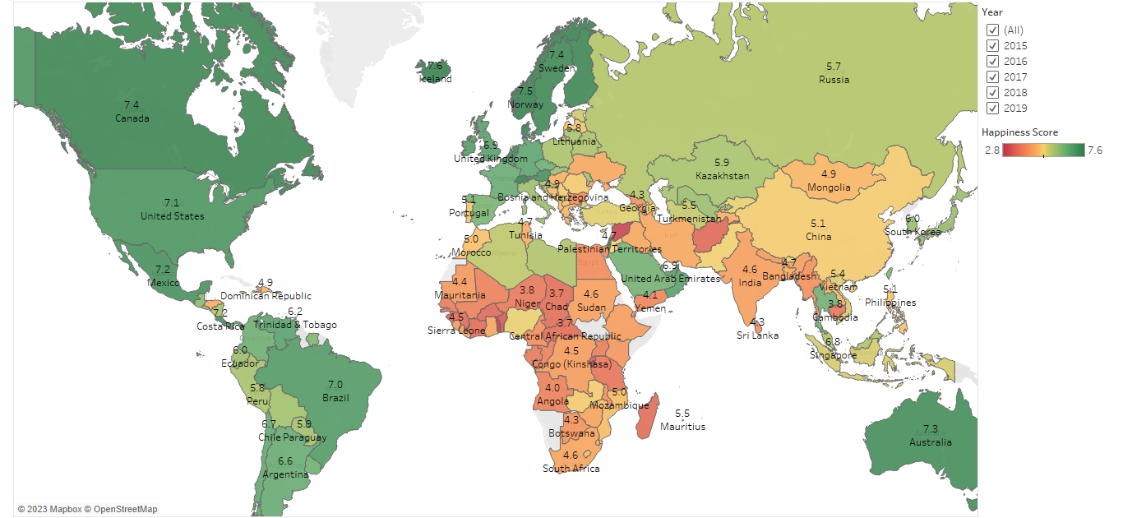

Slide 30
Thank you

